Slide 1
5. Quantum Fourier
Vu Tuan Hai

Slide 2
5.1. Quantum Fourier transform
One of the most useful ways of solving a problem in mathematics or computer science is to transform it into some other problem for which a solution is known

Slide 3

5.1. Discrete Fourier transform
$$ℱ:ℂ^{n}→ℂ^{n}$$
Give a $N$ – dimensional complex vector $x=\left[\begin{matrix}x_{0} & … & x_{N−1}\end{matrix}\right]$
$ℱ\left(x\right)=y$ with $y_{k}=\frac{1}{\sqrt{N}}\sum_{j=0}^{N−1}{x_{j}e^{\frac{2πijk}{N}}=\frac{1}{\sqrt{N}}\sum_{j=0}^{N−1}{x_{j}ω_{N}^{jk}}}$

Slide 4

5.1. Quantum Fourier transform
$$ℱ:\left|j\right\rangle →\frac{1}{\sqrt{N}}\sum_{k=0}^{N−1}{ω_{N}^{jk}|k⟩}$$
Or the unitary matrix:
$${ℱ=U}_{QFT}=\frac{1}{\sqrt{N}}\sum_{j=0}^{N−1}{\sum_{k=0}^{N−1}{ω_{N}^{jk}|k⟩⟨j|}}$$

Slide 5
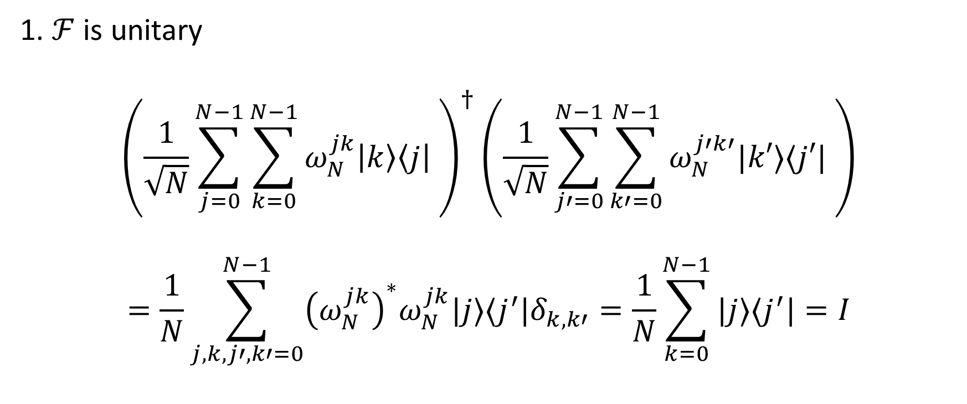
5.1. Quantum Fourier transform
1. $ℱ$ is unitary
$${\left(\frac{1}{\sqrt{N}}\sum_{j=0}^{N−1}{\sum_{k=0}^{N−1}{ω_{N}^{jk}\left|k\right\rangle \left\langle j\right|} }\right)}^{†}\left(\frac{1}{\sqrt{N}}\sum_{j′=0}^{N−1}{\sum_{k′=0}^{N−1}{ω_{N}^{j′k′}|k′⟩⟨j′|} }\right)$$
$$=\frac{1}{N}\sum_{j,k,j′,k′=0}^{N−1}{{\left(ω_{N}^{jk}\right)}^{∗}ω_{N}^{jk}|j⟩⟨j^{′}|δ_{k,k′}=\frac{1}{N}\sum_{k=0}^{N−1}{|j⟩⟨j^{′}|=I}}$$
Notes:
1 + 1 + … = N

Slide 6
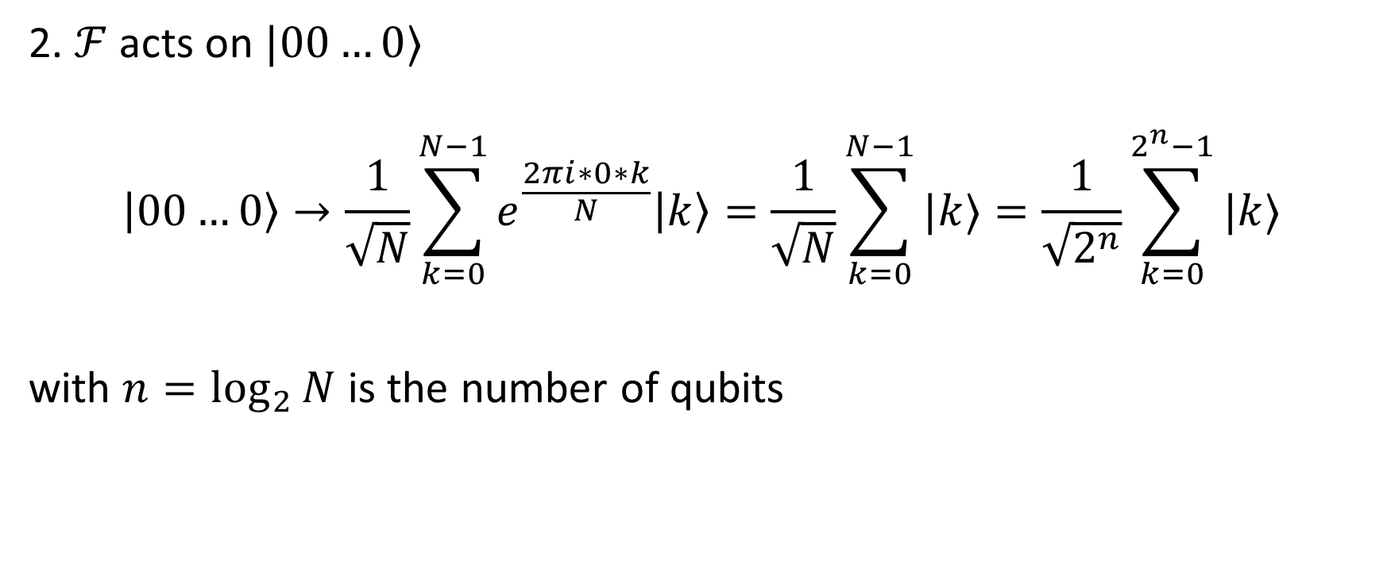
5.1. Quantum Fourier transform
2. $ℱ$ acts on $|00…0⟩$
$$\left|00…0\right\rangle →\frac{1}{\sqrt{N}}\sum_{k=0}^{N−1}{e^{\frac{2πi∗0∗k}{N}}\left|k\right\rangle =\frac{1}{\sqrt{N}}\sum_{k=0}^{N−1}{|k⟩}}=\frac{1}{\sqrt{2^{n}}}\sum_{k=0}^{2^{n}−1}{|k⟩}$$
with $n=\log_{2}{N}$ is the number of qubits

Slide 7

5.1. Quantum Fourier transform
Intuition:
$$ℱ:\left|State in computation basis\right\rangle →|State in Fourier basis⟩$$
$$U_{QFT}\left|x\right\rangle =|\tilde{x}⟩$$
$|\tilde{x}⟩$ denotes for the state in Fourier basis

Slide 8
Computation basis
Fourier basis

Slide 9
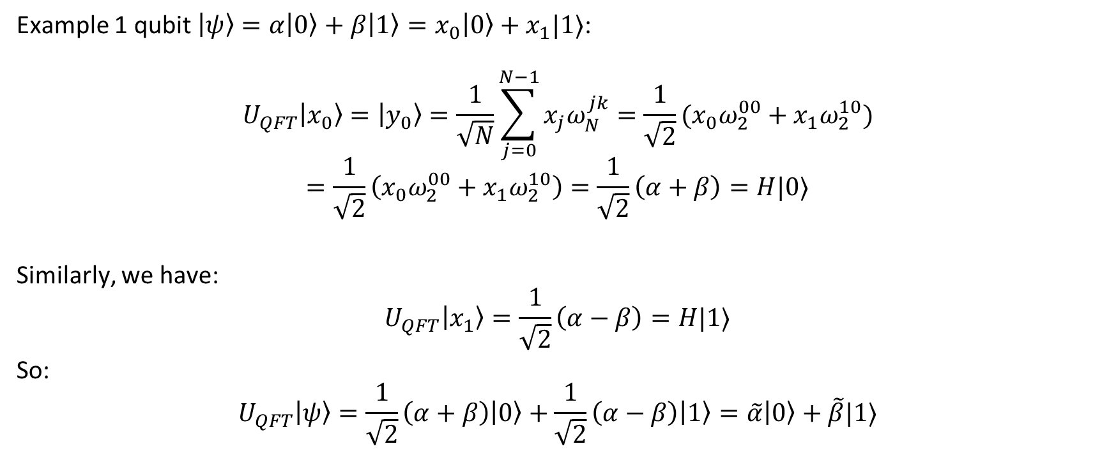
5.1. Quantum Fourier transform
Example 1 qubit $\left|ψ\right\rangle =α\left|0\right\rangle +β\left|1\right\rangle =x_{0}\left|0\right\rangle +x_{1}|1⟩$:
$$U_{QFT}\left|x_{0}\right\rangle =\left|y_{0}\right\rangle =\frac{1}{\sqrt{N}}\sum_{j=0}^{N−1}{x_{j}ω_{N}^{jk}}=\frac{1}{\sqrt{2}}(x_{0}ω_{2}^{00}+x_{1}ω_{2}^{10})$$
$$=\frac{1}{\sqrt{2}}\left(x_{0}ω_{2}^{00}+x_{1}ω_{2}^{10}\right)=\frac{1}{\sqrt{2}}\left(α+β\right)=H|0⟩$$
Similarly, we have:
$$U_{QFT}\left|x_{1}\right\rangle =\frac{1}{\sqrt{2}}\left(α−β\right)=H|1⟩$$
So:
$$U_{QFT}\left|ψ\right\rangle =\frac{1}{\sqrt{2}}\left(α+β\right)\left|0\right\rangle +\frac{1}{\sqrt{2}}\left(α−β\right)\left|1\right\rangle =\tilde{α}\left|0\right\rangle +\tilde{β}|1⟩$$

Slide 10
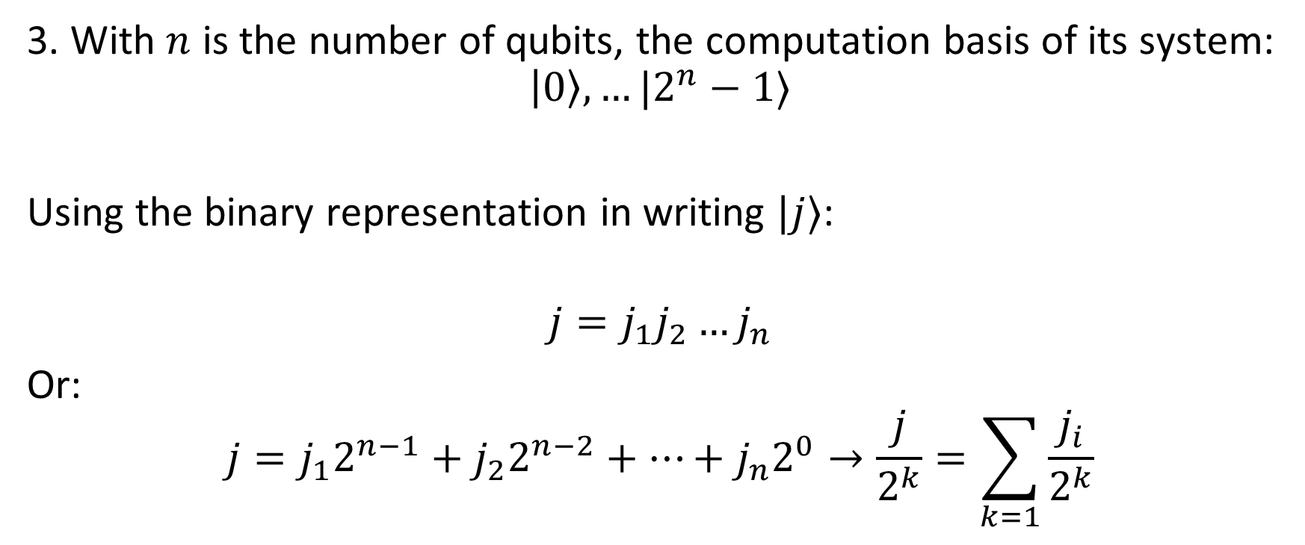
5.1. Quantum Fourier transform
3. With $n$ is the number of qubits, the computation basis of its system:
$$\left|0\right\rangle ,…|2^{n}−1⟩$$
Using the binary representation in writing $|j⟩$:
$$j=j_{1}j_{2}…j_{n}$$
Or:
$$j=j_{1}2^{n−1}+j_{2}2^{n−2}+…+j_{n}2^{0}→\frac{j}{2^{k}}=\sum_{k=1}{\frac{j_{i}}{2^{k}}}$$

Slide 11
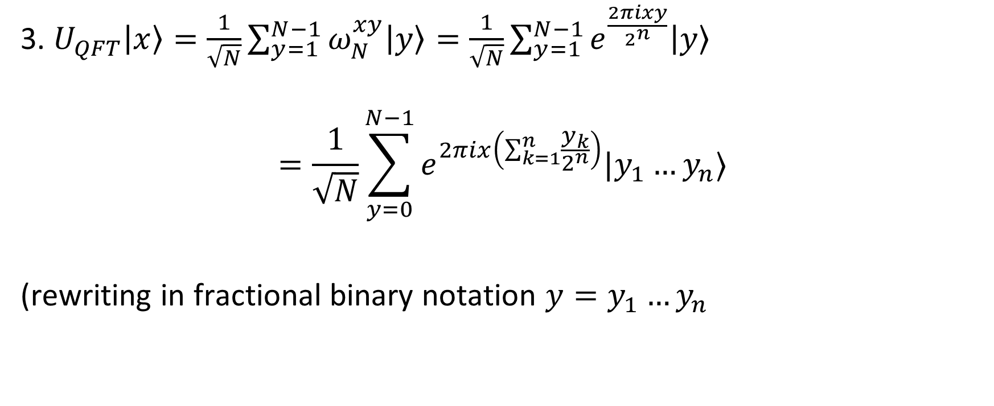
5.1. Quantum Fourier transform
3. $U_{QFT}\left|x\right\rangle =\frac{1}{\sqrt{N}}\sum_{y=1}^{N−1}{ω_{N}^{xy}\left|y\right\rangle =\frac{1}{\sqrt{N}}\sum_{y=1}^{N−1}{e^{\frac{2πixy}{2^{n}}}\left|y\right\rangle }}$
$$=\frac{1}{\sqrt{N}}\sum_{y=0}^{N−1}{e^{2πix\left(\sum_{k=1}^{n}{\frac{y_{k}}{2^{n}}}\right)}|y_{1}…y_{n}⟩}$$
(rewriting in fractional binary notation $y=y_{1}…y_{n}$

Slide 12
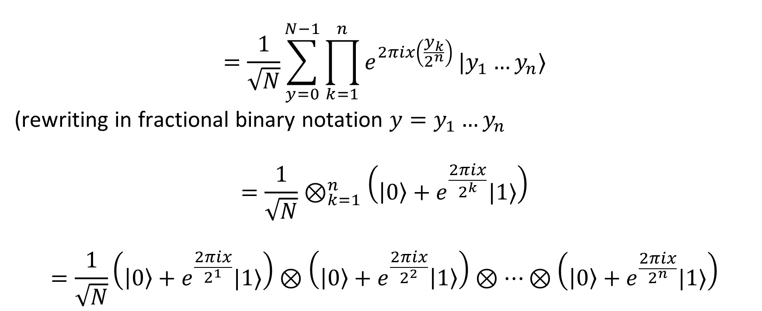
5.1. Quantum Fourier transform
$$=\frac{1}{\sqrt{N}}\sum_{y=0}^{N−1}{\prod_{k=1}^{n}{e^{2πix\left(\frac{y_{k}}{2^{n}}\right)}}|y_{1}…y_{n}⟩}$$
(rewriting in fractional binary notation $y=y_{1}…y_{n}$
$$=\frac{1}{\sqrt{N}}⊗_{k=1}^{n}\left(\left|0\right\rangle +e^{\frac{2πix}{2^{k}}}|1⟩\right)$$
$$=\frac{1}{\sqrt{N}}\left(\left|0\right\rangle +e^{\frac{2πix}{2^{1}}}|1⟩\right)⊗\left(\left|0\right\rangle +e^{\frac{2πix}{2^{2}}}\left|1\right\rangle \right)⊗…⊗\left(\left|0\right\rangle +e^{\frac{2πix}{2^{n}}}|1⟩\right)$$

